Slide 1
Logistic Regression

Slide 2
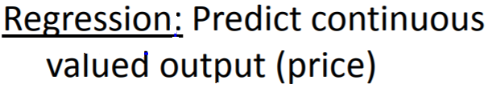
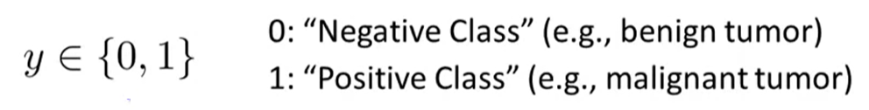
Regression Classification
House pricing
Person’s income
Email: Spam / Not Spam?
Online Transactions: Fraudulent (yes/no)
Tumor: Malignant/ Benign ?

Slide 3
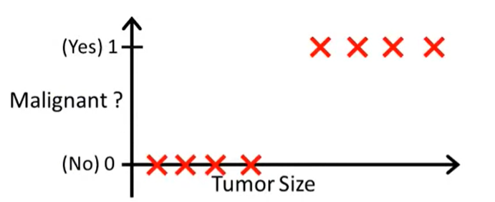
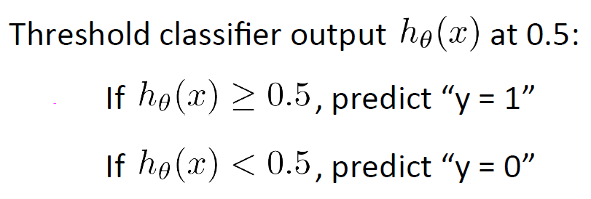
Linear Regression Vs Logistic Regression

Slide 4
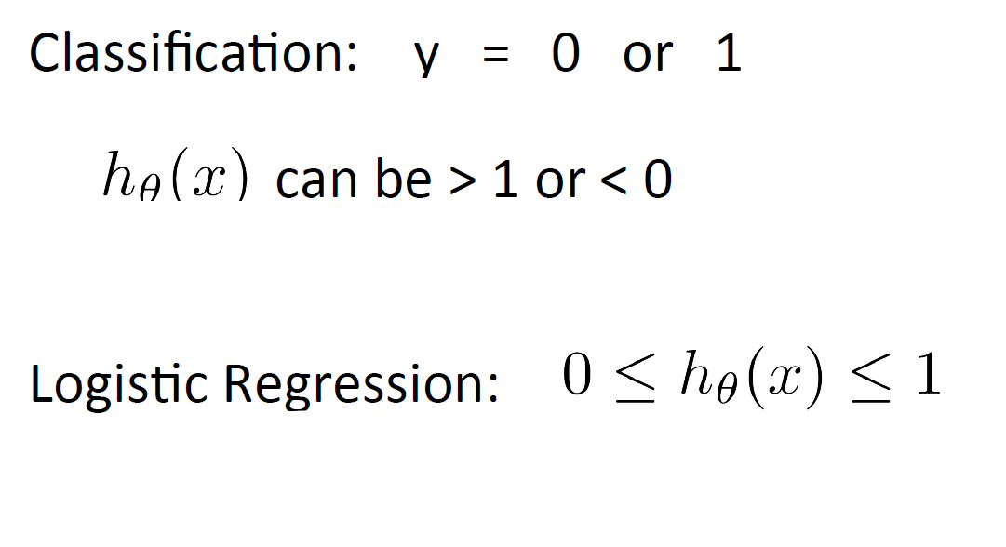
Linear Regression Vs Logistic Regression

Slide 5
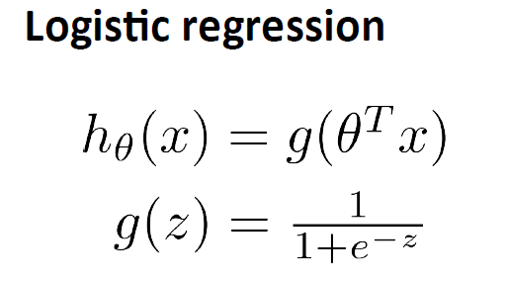



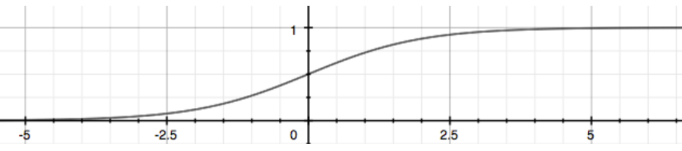
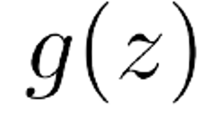

Logistic Regression

Slide 6
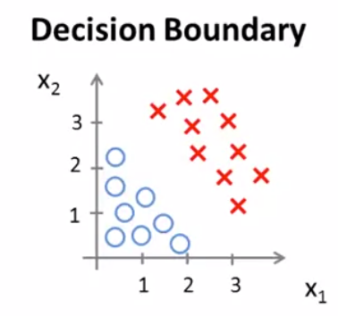




Logistic Regression
-3 1 1
=

Slide 7
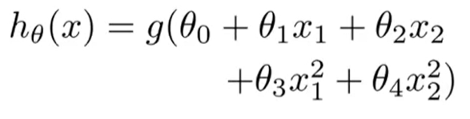
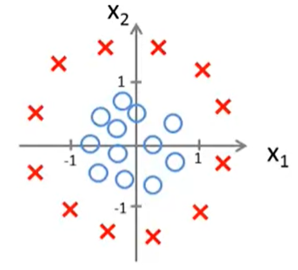


Logistic Regression
-1 0 0
-1 1

